Slide 1
Volume of Shapes
Miss L
Year 11 Essentials

Slide 2
Learning Intentions
Students will be able to
calculate the volume of cubes and rectangular and triangular prisms

Slide 3
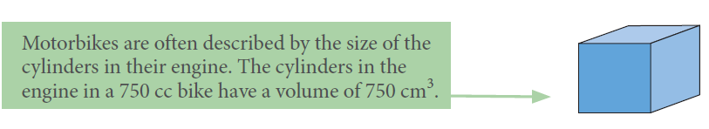
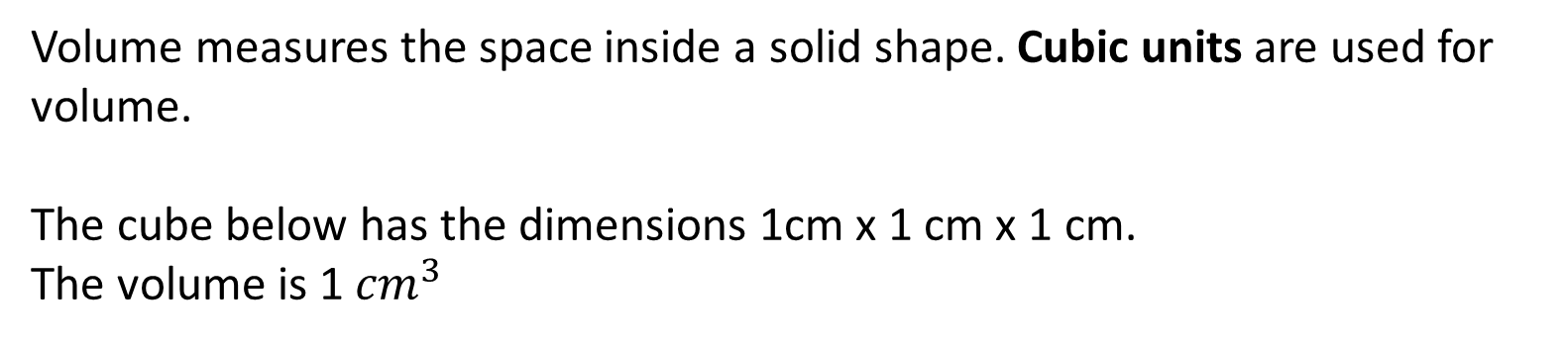
24
7
30
Volume of Shapes
Date
EQ – How to find the volume of cubes, rectangular and triangular prisms?
What is Volume?
Volume measures the space inside a solid shape. Cubic units are used for volume.
The cube below has the dimensions 1cm x 1 cm x 1 cm.
The volume is 1 ${cm}^{3}$

Slide 4
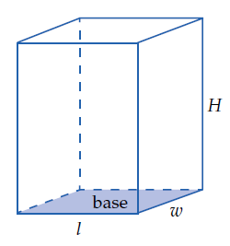
24
7
30
Volume of Shapes
Date
EQ – How to find the volume of cubes, rectangular and triangular prisms?
Rectangular Prims Formula
Volume = length x width x height
= L x W x H

Slide 5
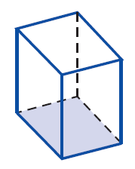
24
7
30
Volume of Shapes
Date
EQ – How to find the volume of cubes, rectangular and triangular prisms?
Rectangular Prims Formula
For solids with identical cross-sections
Volume = Area of Base x Height

Slide 6
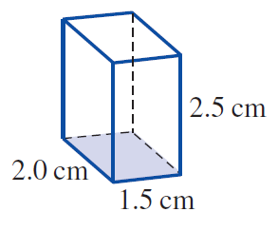
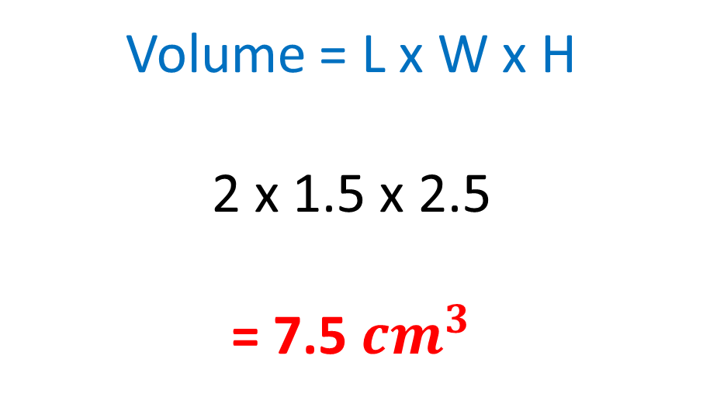
Practice
Volume = L x W x H
2 x 1.5 x 2.5
= 7.5 ${cm}^{3}$

Slide 7
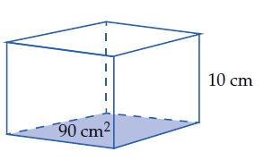
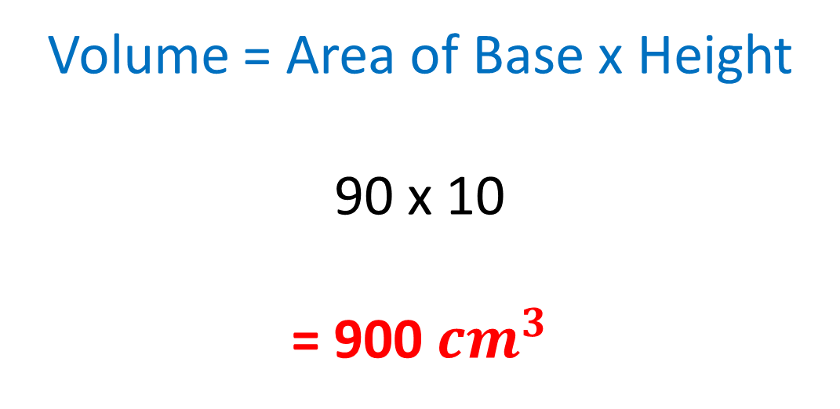
Practice
Volume = Area of Base x Height
90 x 10
= 900 ${cm}^{3}$

Slide 8


Slide 9
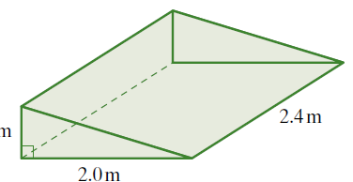

24
7
30
Volume of Shapes
Date
EQ – How to find the volume of cubes, rectangular and triangular prisms?
Volume of a Triangle = $\frac{1}{2}×b×h×l$
Volume of a triangle formula
Length
Height
Base

Slide 10
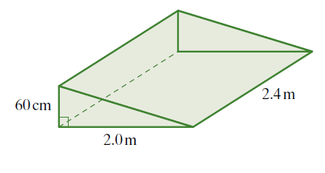
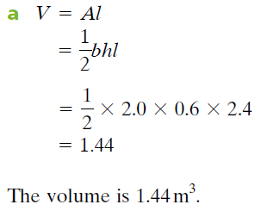
Practice

Slide 11
Task
Complete worksheet on Volume

